Slide 1

Tumor Diagnostics
Linnea Hall
Corrin Graue

Slide 2
Problem Statement
How do you improve cancer tumor diagnosis using biopsies?
Increase speed, accuracy, and autonomy
Reduce objectivity
Define cell features that separate benign from malignant tumors
Notes:
Common area of research

Slide 3
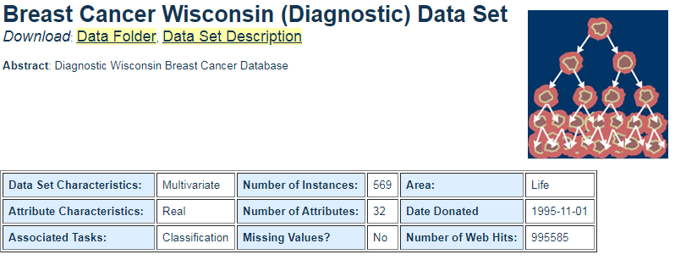
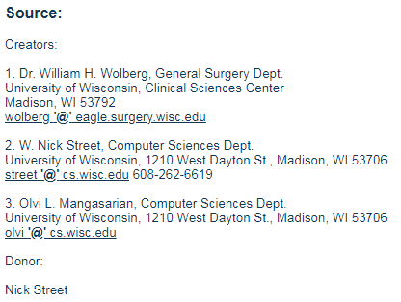

Slide 4
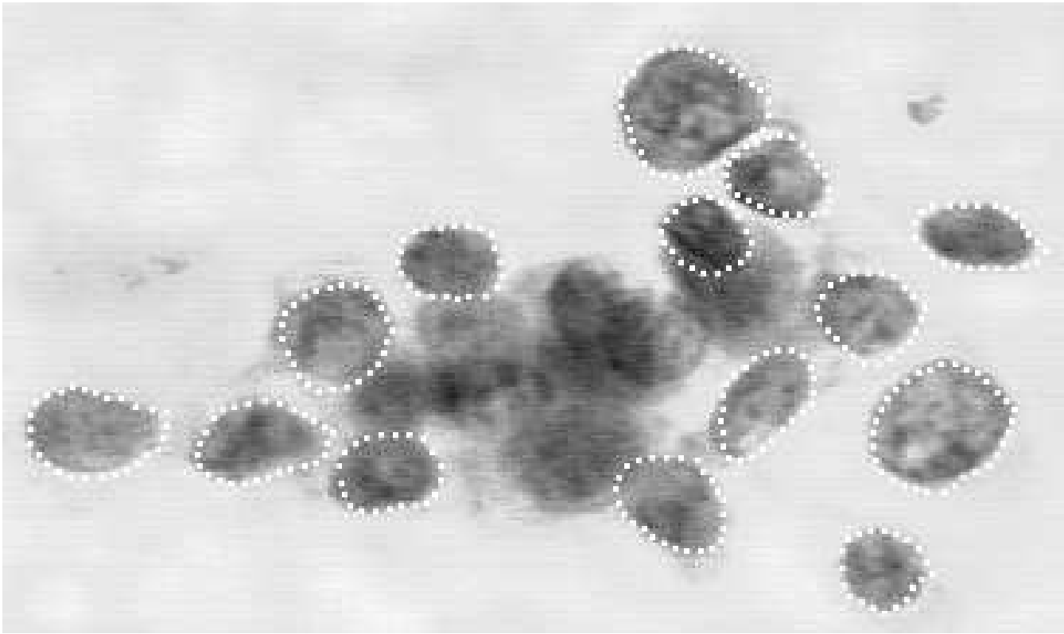
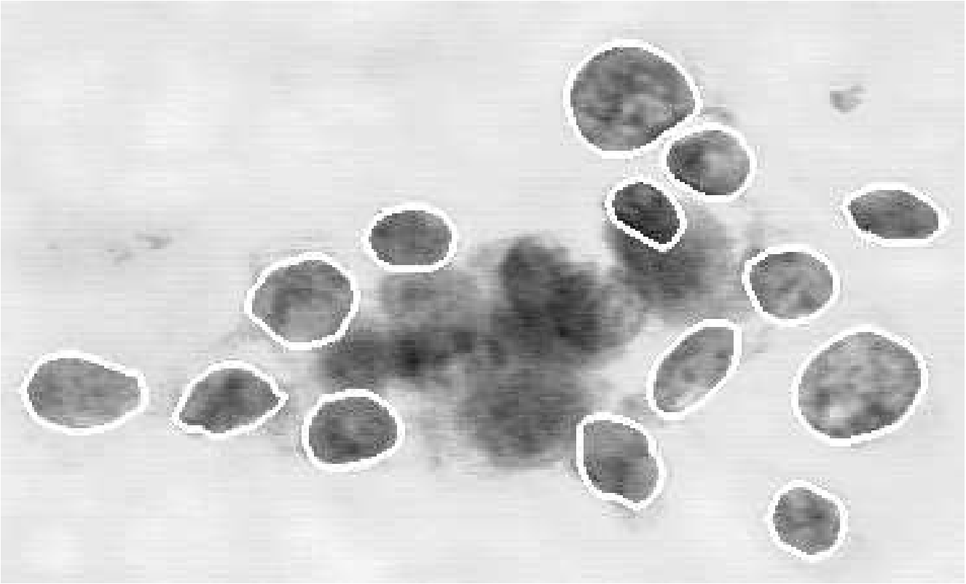
Data set description
569 patient biopsies
Tumor fluid collection by fine needle (FNA)
Stained slide
Manual boundary designation
Spline contour to define actual boundary
W.N. Street, W.H. Wolberg and O.L. Mangasarian. Nuclear feature extraction for breast tumor diagnosis. IS&T/SPIE 1993 International Symposium on Electronic Imaging: Science and Technology, volume 1905, pages 861-870, San Jose, CA, 1993.
Notes:
We found data where this sort of analysis was performed on breast tumors
Data is comprised of results from 569 Fine needle aspirate slide images.
Once the image is digitized, users manually estimate nuclear boundaries by drawing rough outlines

Slide 5
Data set description
Radius
Perimeter
Area
Compactness
Smoothness
Concavity
Concave points
Symmetry
Fractal dimension
Texture
32 features
Notes:
Features include whether the biopsy was diagnosed as benign or malignant

Slide 6
Background
Breast cancer(BC) is the most prevalent cancer in women and has always had a high incidence and mortality rate.
BC is expected to account for 25% of all new cancer diagnoses and 15% of all cancer deaths among women worldwide.
Due to focus on early detection, mortality rate is on a trending decline over the past decades.
  5 year survival rate for BC is almost 100% if detected at it’s earliest stage, but as low as 15% if detected at its latest stage, according to Cancer Research UK
Yue, Wenbin, Zidong Wang, Hongwei Chen, Annette Payne, and Xiaohui Liu. "Machine Learning with Applications in Breast Cancer Diagnosis and Prognosis." Designs 2.2 (2018): 13. Web.

Slide 7
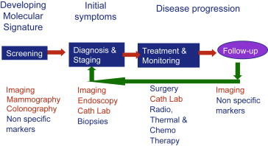
Imaging occurs throughout the course of disease monitoring
"Image guided and targeted minimally invasive therapy has the promise to improve outcome and reduce collateral effects."
L. Fass. Imaging and Cancer: a review. Molecular Oncology, volume 2 Issue 2, pages 115-152, August 2008.

Slide 8
Traditional Stats vs ML
The increasing complexity and quantity of medical data shows the need for ML techniques over traditional statistical methods.
A 2004 study compared two ML techniques(decision tree & artificial neural network) to a standard linear regression on a BC dataset with 200,000 test cases. The accuracy of each method in predicting BC survival is as follows:
  DT : 93.6%
  ANN: 91.2%
  LR: 89.2%
  Delen, D.; Walker, G.; Kadam, A. Predicting breast cancer survivability: A comparison of three data mining methods. Artif. Intell. Med. 2005, 34, 113–127

Slide 9
ML to the Rescue!
ML techniques are playing a significant role in diagnosis and prognosis of BC by applying classification techniques to identify people with BC, distinguish benign from malignant tumors, and to predict prognosis.
This paper focuses on the ML techniques employed on the benchmark dataset for breast cancer research: Wisconsin Breast Cancer Diagnosis (WBCD).

Slide 10
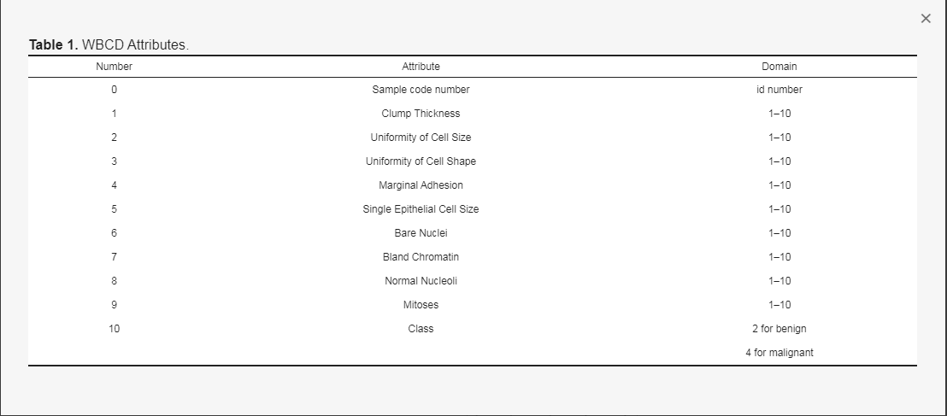
WBCD Database
BC can be diagnosed accurately (94.36%-99.9%) based on 9 attributes from the dataset.

Slide 11
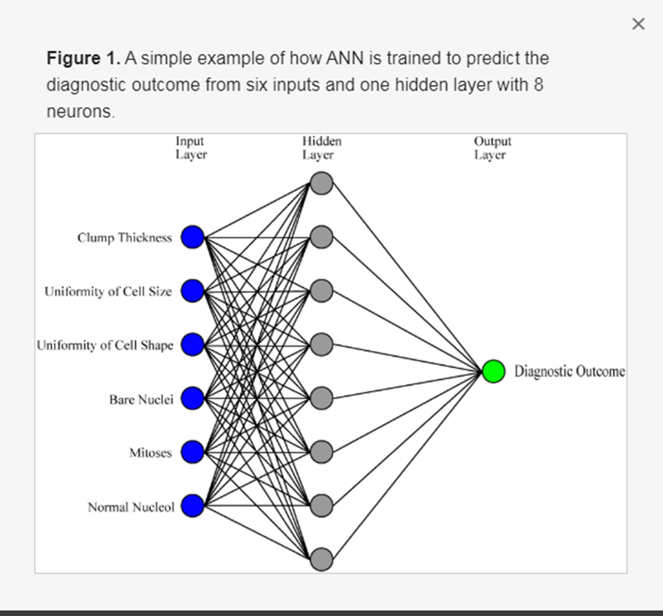
Artificial Neural Networks (ANNs)
ANNs have shown success and great progress in BC classification and diagnosis in very early stages.

Slide 12
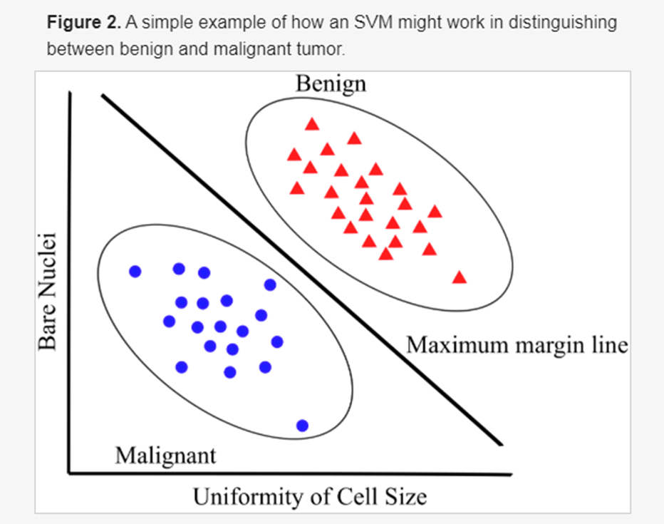
Support Vector Machine(SVM)
SVM is one of the most popular approaches in BC diagnosis and prognosis.

Slide 13
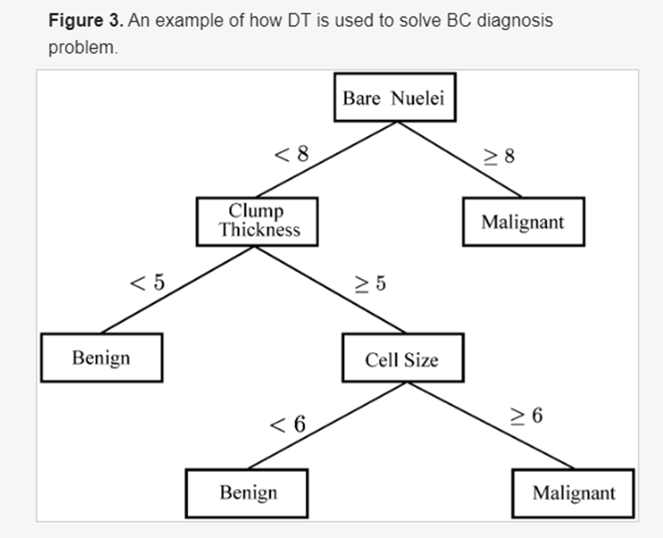
Decision Tree (DT)
A DT is a tree-like classifier that partitions every possible outcome of data recursively into classes.

Slide 14
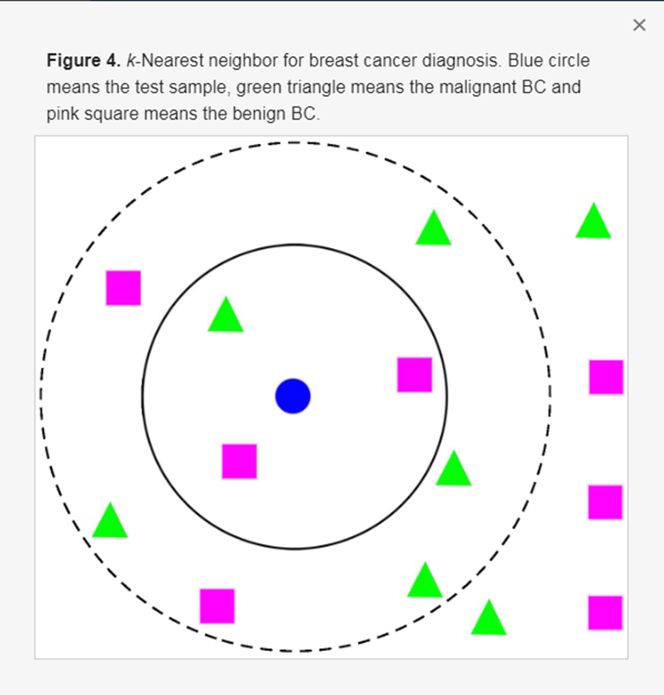
K- Nearest Neighbor
An example of k-NN structure is presented for determining BC diagnosis and prognosis if k=3
the test sample(circle) is assigned to malignant BC(square) because there are 2 squares and only 1 triangle inside the inner circle.
If k=5, the test sample is assigned to benign BC(triangle).

Slide 15
Future Work
All of these techniques focus on classification accuracy, but further work should be done to improve on BC prediction models.
It’s important to note that ML techniques have been used to predict BC tumor class, but differences between individual patients, even within the same BC class, can require different treatment plans.

Slide 16
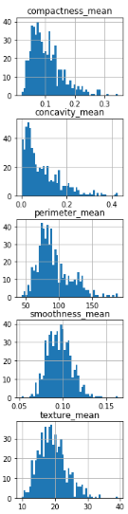
Descriptive statistics
Data considerations:
Data is unbalanced
small n= 569
Need to address potential outliers

